Slide 1
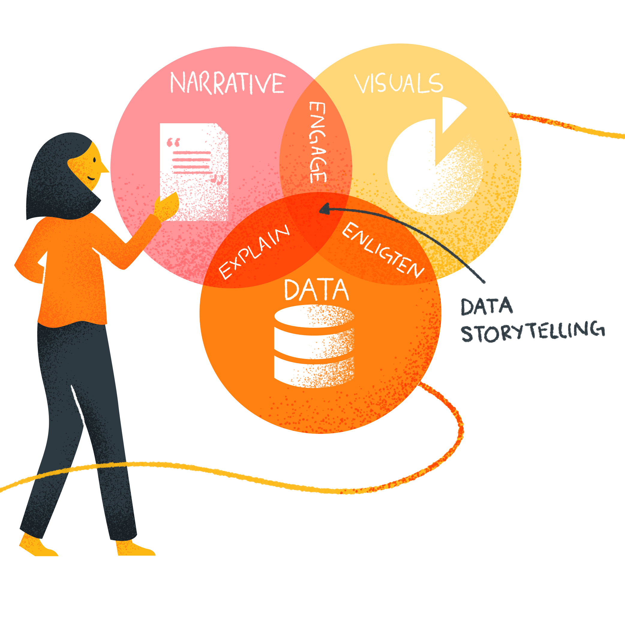
Intentional
Data Storytelling
Notes:
Health
Education
Poverty

Slide 2
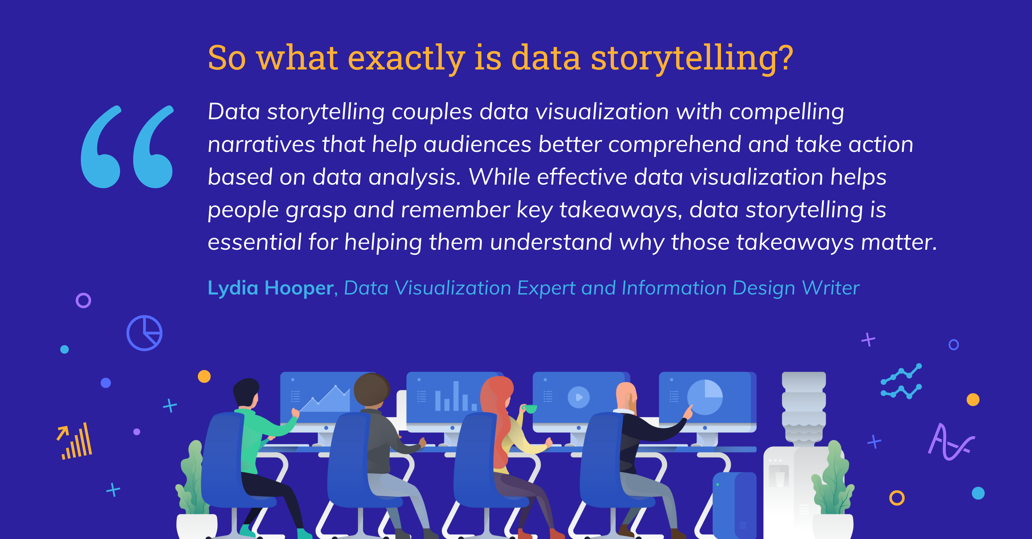

Slide 3


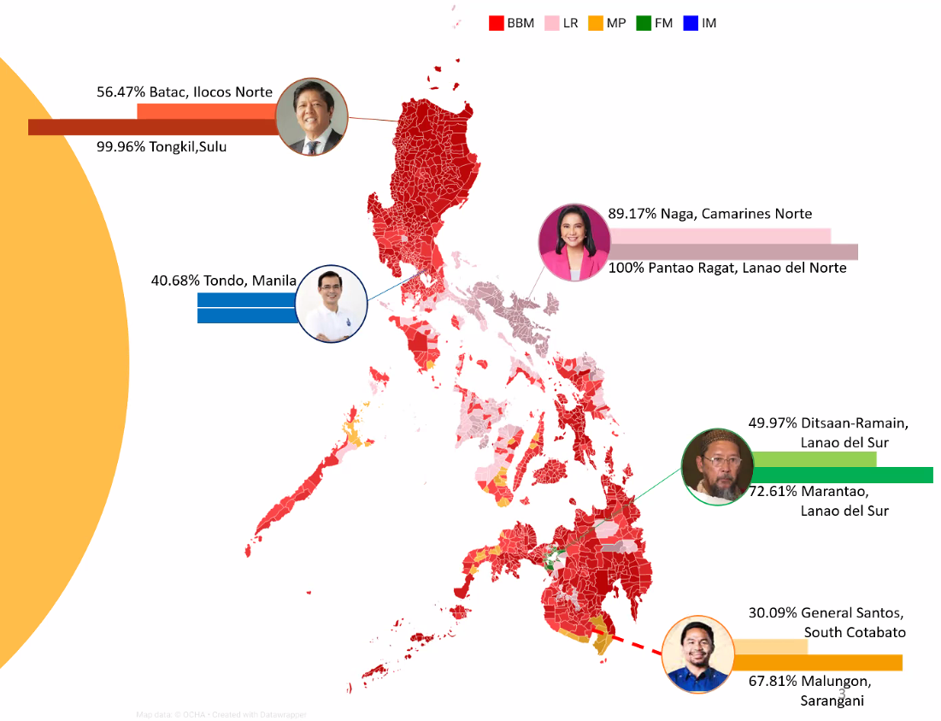
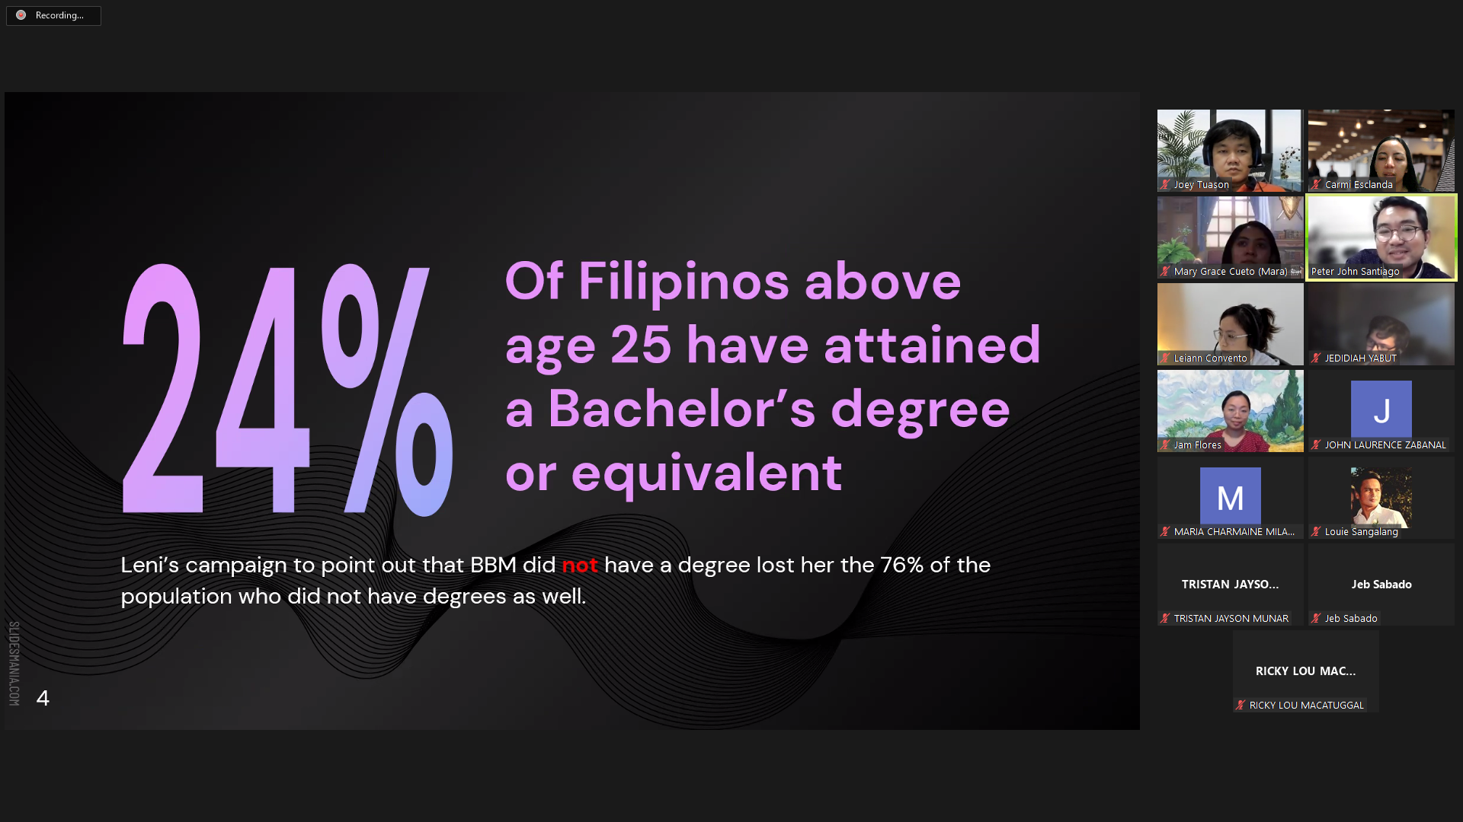
Data Storytelling
& Visualization
05 September 2020
Notes:
Storytelling with data differs from data visualization because it requires communicators to offer a larger, holistic, view of their message. You must focus first on your audience and structure a larger message before any visuals are rendered. You must identify from the start:
What do I want my audience to know or do with the data I am presenting?
How will I structure a narrative that leads to desired action?
How is my data helping drive a decision?

Slide 4



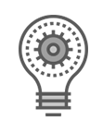

Data Storytelling
The
Art
The
Purpose
The
Message
The
Assets
The
Tips
Notes:
How to approach your data, select the right
visualizations and put it all together into a
compelling data story.

Slide 5
Data Storytelling
The
Art
The
Purpose
The
Message
The
Assets
The
Tips
Notes:
How to approach your data, select the right
visualizations and put it all together into a
compelling data story.

Slide 6
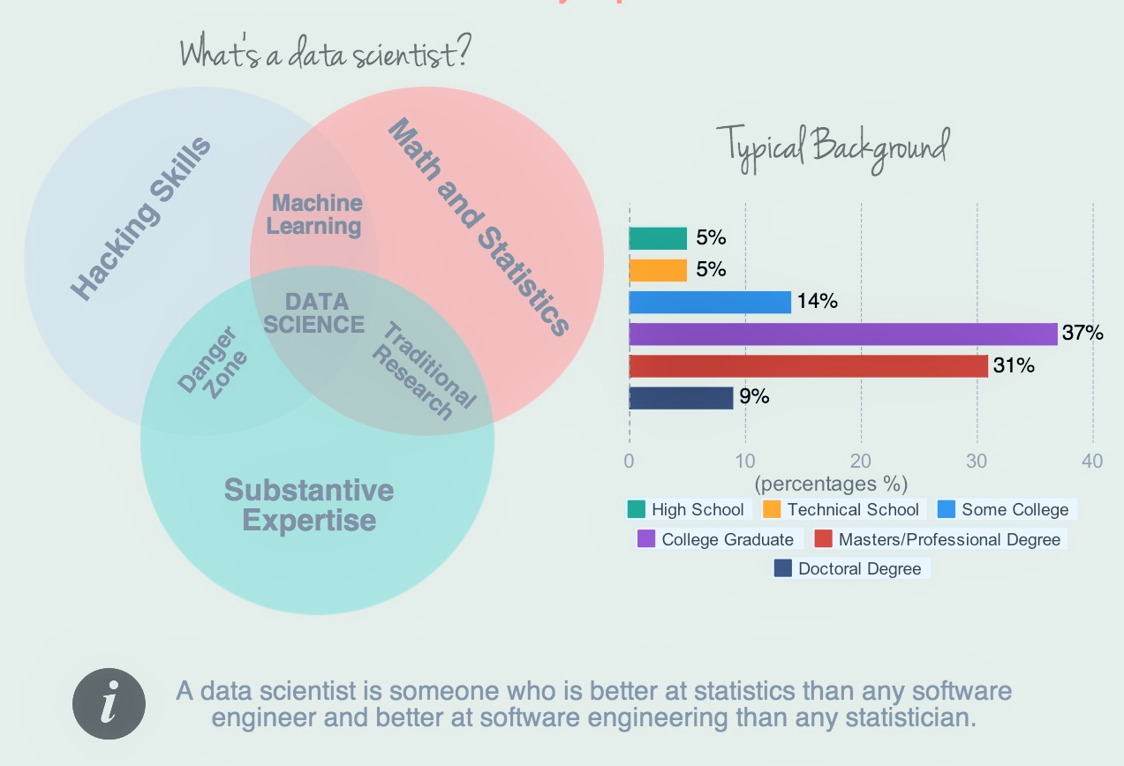
The Art
Data is just a collection of numbers until you turn it into a story. Showing reports and dashboards can be overwhelming without adding a narrative to the data. Any great insight explains what happened, why it is important and how you can use it to turn it into something actionable.
-Forbes
Data Science is an Art
Notes:
Once, a great person told me that data science is an art . What do you think ----?
Data science: This field of expertise is the interdisciplinary field of sciences, which extracts knowledge and insight from data, making it readily available. This exciting field has made significant changes to our daily lives in the past couple of decades.
The technologies we take for granted are all driven by this field of expertise, but there is one thing that data scientists are not naturally skilled in:

Slide 7
Data is everywhere: whether you choose a new location for your business or decide on the color to use in an ad, data is an invisible advisor that helps make impactful decisions. With quite a number of resources to choose from, data is becoming more accessible, day by day. But as soon as it has been collected, one inevitable question arises: how do I turn this data into insights that can be acted upon?
Data storytelling is not only about getting to know what’s going on, but about understanding why this is going on and what can be done about it.
Any great story means visualization and detail. It takes the small additions of those details to build a picture in someone’s mind to truly make the story complete. - FORBES
The Art
Data Storytelling is an Art
Notes:
Data presentation is not just about informing, it goes beyond – its about persuading

Slide 8



Data is everywhere: whether you choose a new location for your business or decide on the color to use in an ad, data is an invisible advisor that helps make impactful decisions. With quite a number of resources to choose from, data is becoming more accessible, day by day. But as soon as it has been collected, one inevitable question arises: how do I turn this data into insights that can be acted upon?
Data storytelling is not only about getting to know what’s going on, but about understanding why this is going on and what can be done about it.
Any great story means visualization and detail. It takes the small additions of those details to build a picture in someone’s mind to truly make the story complete. - FORBES
The Art
Notes:
Data presentation is not just about informing, it goes beyond – its about persuading

Slide 9
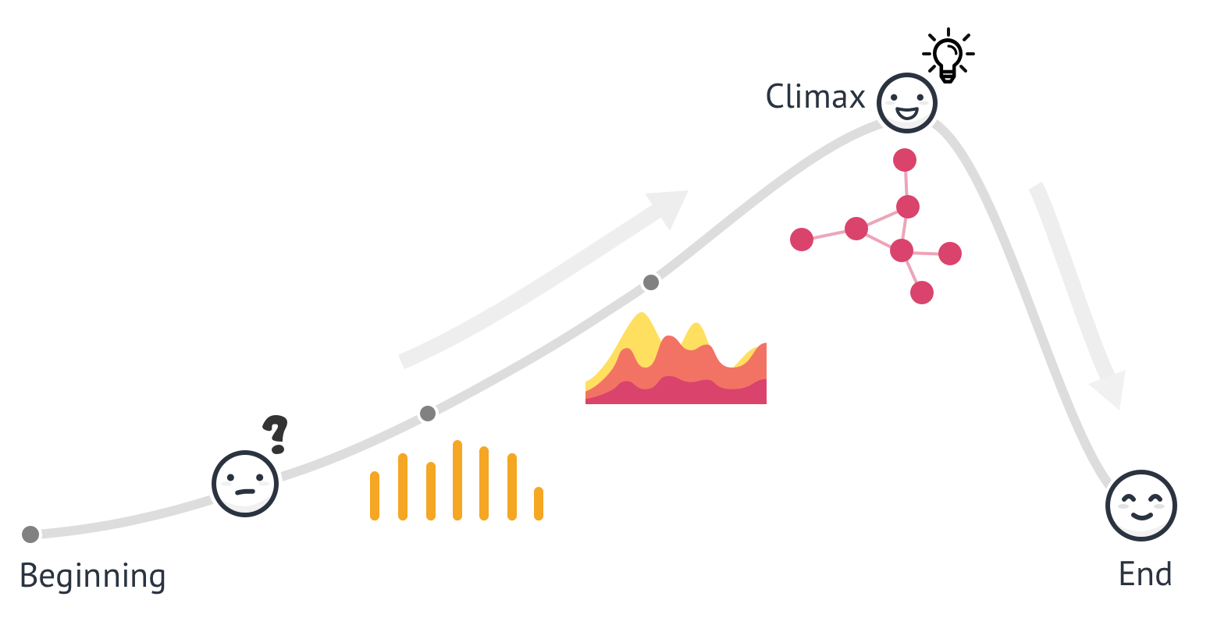
Data is everywhere: whether you choose a new location for your business or decide on the color to use in an ad, data is an invisible advisor that helps make impactful decisions. With quite a number of resources to choose from, data is becoming more accessible, day by day. But as soon as it has been collected, one inevitable question arises: how do I turn this data into insights that can be acted upon?
Data storytelling is not only about getting to know what’s going on, but about understanding why this is going on and what can be done about it.
Any great story means visualization and detail. It takes the small additions of those details to build a picture in someone’s mind to truly make the story complete. - FORBES
The Art
Source : Medium.com
Notes:
Data presentation is not just about informing, it goes beyond – its about persuading

Slide 10
The Art
In Data Storytelling,
we give voice to the data
for effective insights
Notes:
Data presentation is not just about informing, it goes beyond – its about persuading

Slide 11
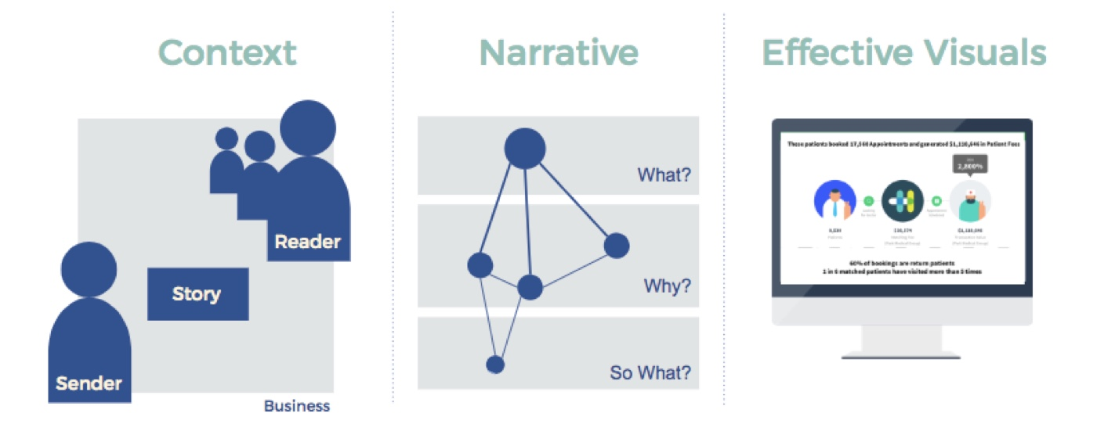
Data is everywhere: whether you choose a new location for your business or decide on the color to use in an ad, data is an invisible advisor that helps make impactful decisions. With quite a number of resources to choose from, data is becoming more accessible, day by day. But as soon as it has been collected, one inevitable question arises: how do I turn this data into insights that can be acted upon?
Data storytelling is not only about getting to know what’s going on, but about understanding why this is going on and what can be done about it.
Any great story means visualization and detail. It takes the small additions of those details to build a picture in someone’s mind to truly make the story complete. - FORBES
The Art
Notes:
Lets look at

Slide 12
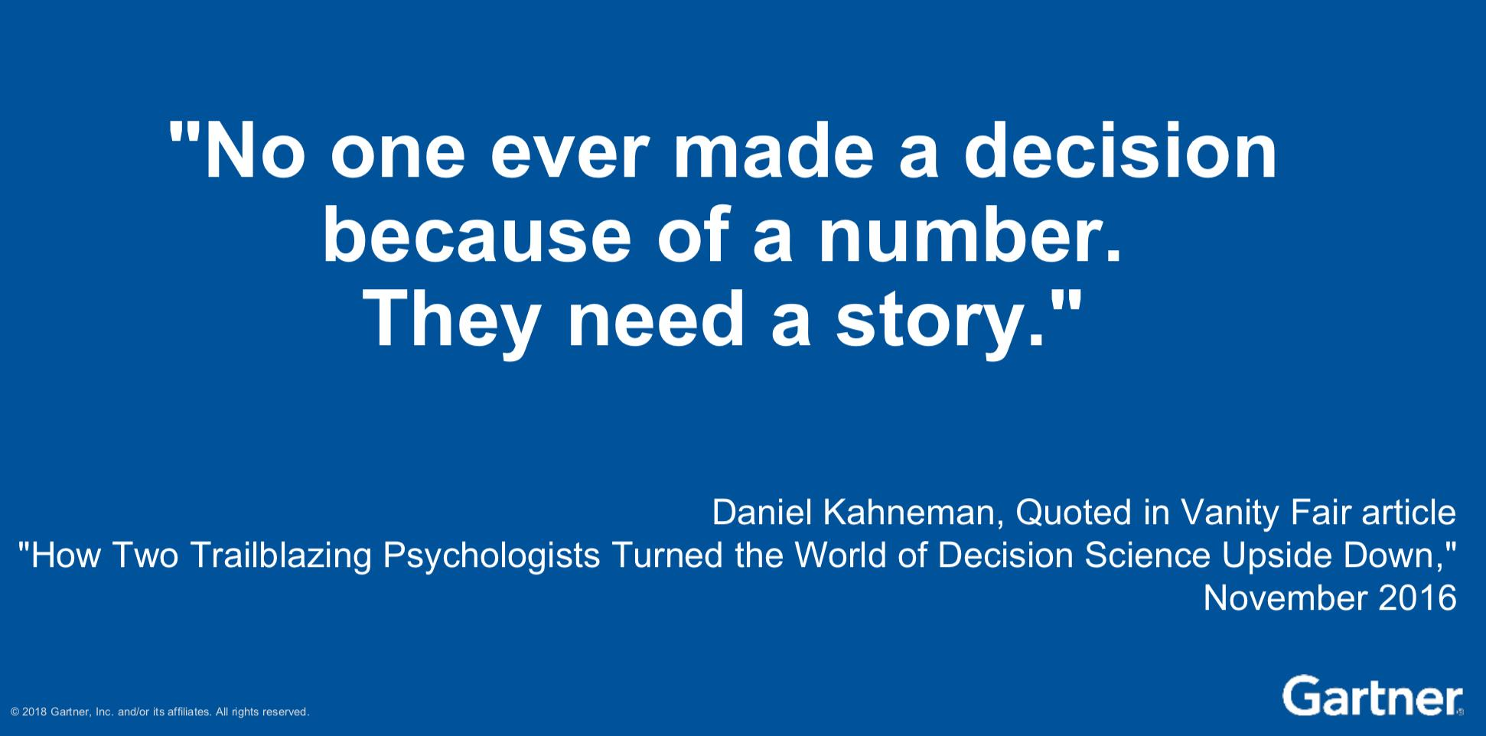

Slide 13
The Purpose
Data Storytelling is Intentional
Notes:
Data presentation is not just about informing, it goes beyond – its about persuading

Slide 14
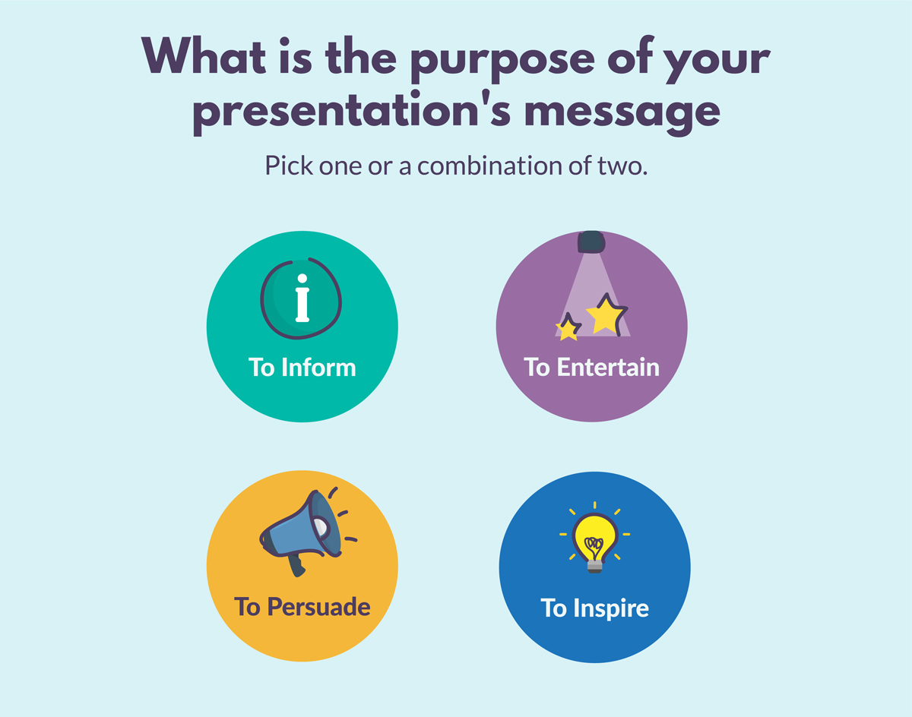
The Purpose
Notes:
Data presentation is not just about informing, it goes beyond – its about persuading

Slide 15
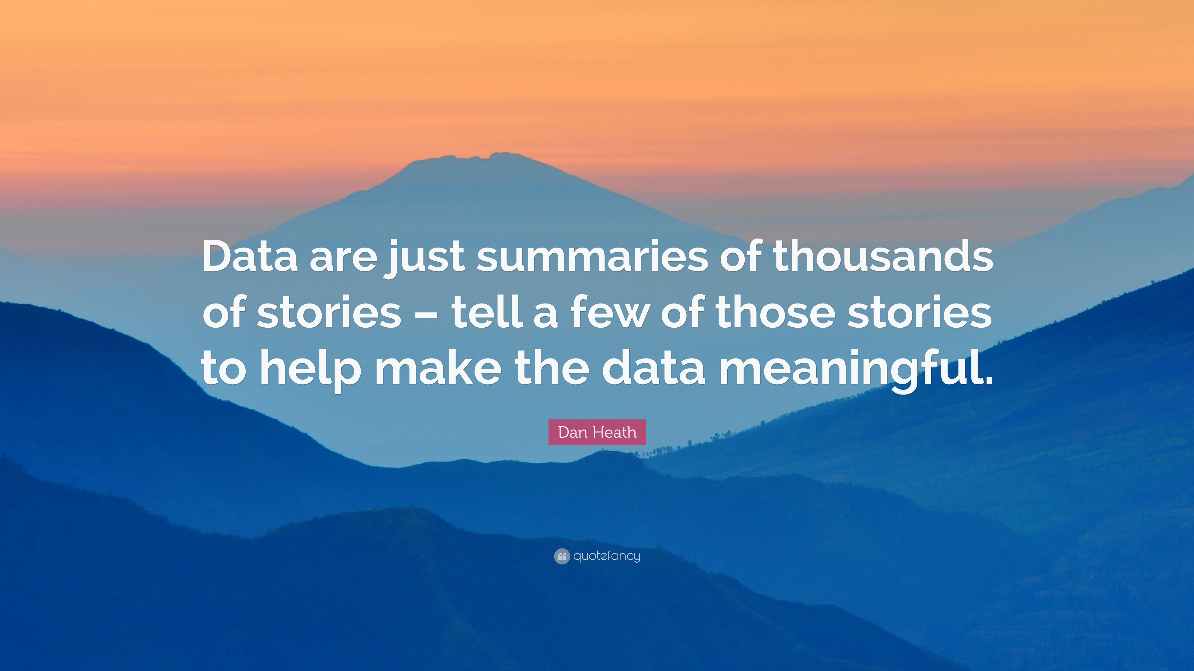
Notes:
Ask their expectations

Slide 16
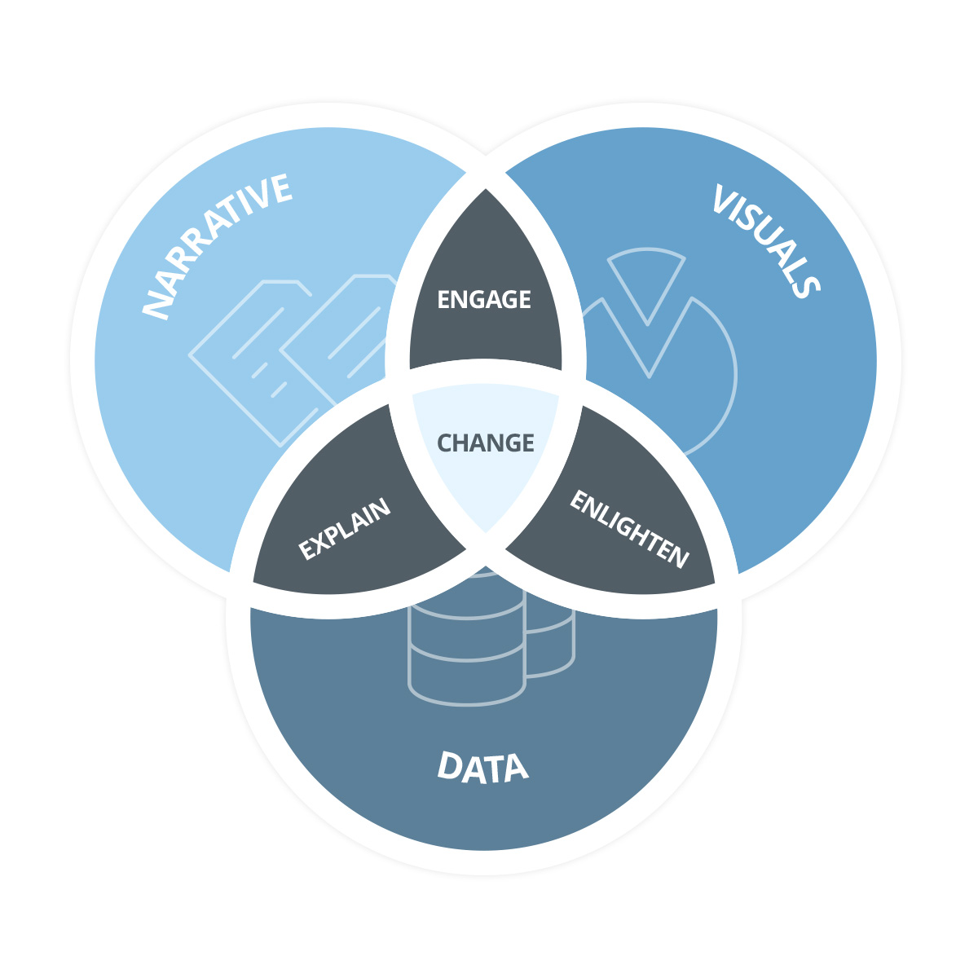
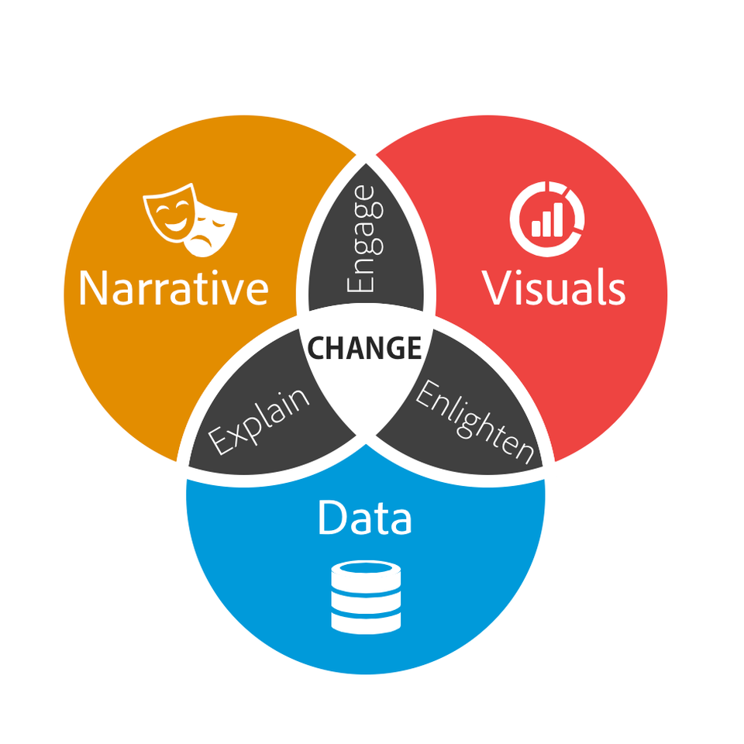

The Purpose
Source : Domo.com
Notes:
Every story should have a purpose.

Slide 17
The Message
Data Storytelling should be kept simple
Notes:
The best way to tell a data-based story is to keep it simple—don't let the story get lost in the numbers. When storytellers overwhelm readers with numbers, the message doesn't land. Remember: Use the numbers that are most relevant and necessary to paint an accurate picture.

Slide 18
The Message
What is your overall goal of your data analysis?
Who is this message intended for? What do you know about your audience?
What do you want to answer?
What kind of relationships exist in your data?
What are the best techniques for displaying these?
Do you need a chart (overview), a table (details), or maybe both, to convey your message?
Can you highlight specific data points to better get your message across?
How can you incorporate a summary of your message in your chart titles to emphasize on your overall message?
Notes:
Data presentation is not just about informing, it goes beyond – its about persuading

Slide 19
The Message
Data Storytelling is
audience-specific
Notes:
Know Your Audience
Get to know your audience then use precognitive attributes to create great
data visualizations that resonate with them. Precognitive attributes mean the
image is being processed without any conscious effort. Communicating in
this way means there is no need for explanation on top of the visualizations.

Slide 20
What have you learned so far?
05 September 2020
Notes:
The plastic wastage

Slide 21
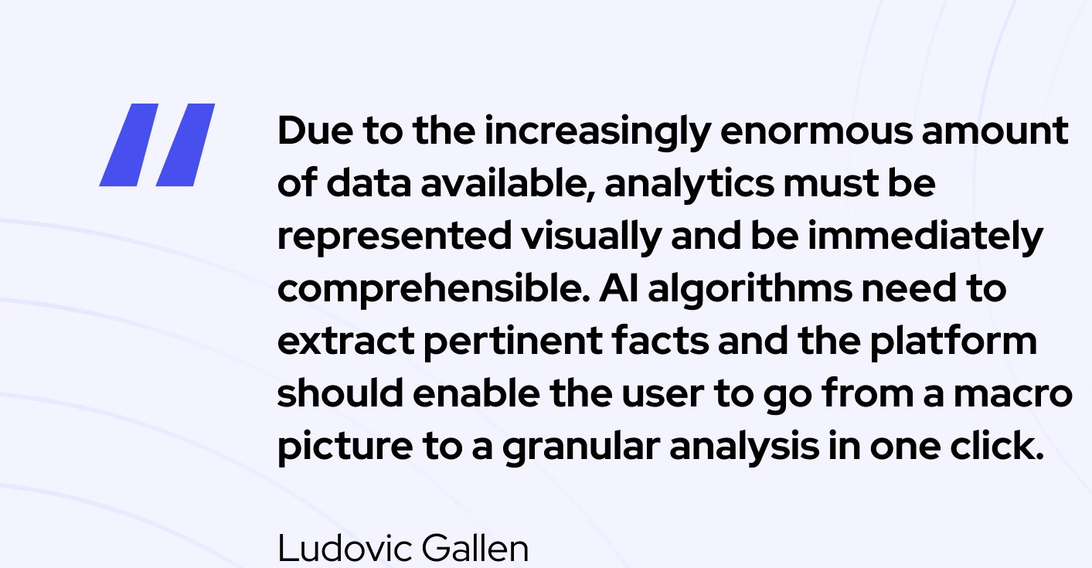



Slide 22
The Assets
Data Storytelling needs
originality
Notes:
Know Your Audience
Get to know your audience then use precognitive attributes to create great
data visualizations that resonate with them. Precognitive attributes mean the
image is being processed without any conscious effort. Communicating in
this way means there is no need for explanation on top of the visualizations.

Slide 23
The Assets
The framework of your presentation starts with your understanding of the business task
Notes:
Know Your Audience
Get to know your audience then use precognitive attributes to create great
data visualizations that resonate with them. Precognitive attributes mean the
image is being processed without any conscious effort. Communicating in
this way means there is no need for explanation on top of the visualizations.

Slide 24
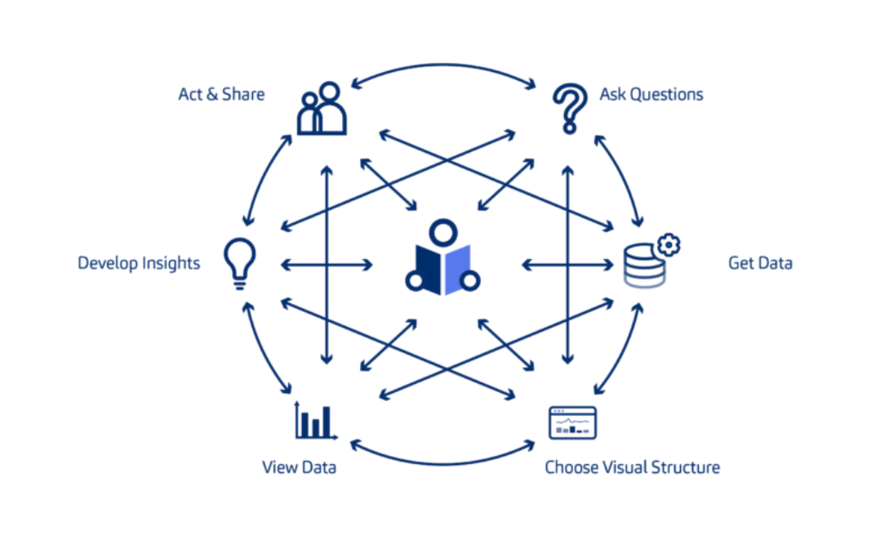

The Assets
People
Problem/Question
Insight/Idea
Data
Visualization
Tools
Source : Vizlib.com
Notes:
Know Your Audience
Get to know your audience then use precognitive attributes to create great
data visualizations that resonate with them. Precognitive attributes mean the
image is being processed without any conscious effort. Communicating in
this way means there is no need for explanation on top of the visualizations.

Slide 25
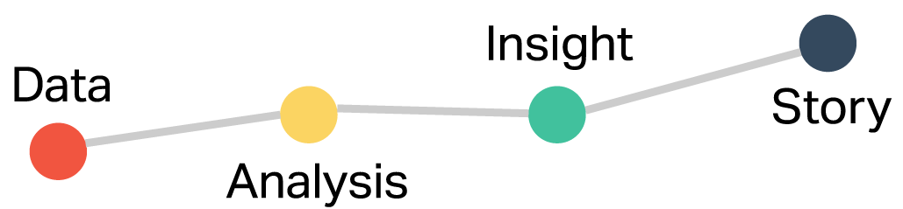
The Assets
should be effectively used to present this:

Slide 26
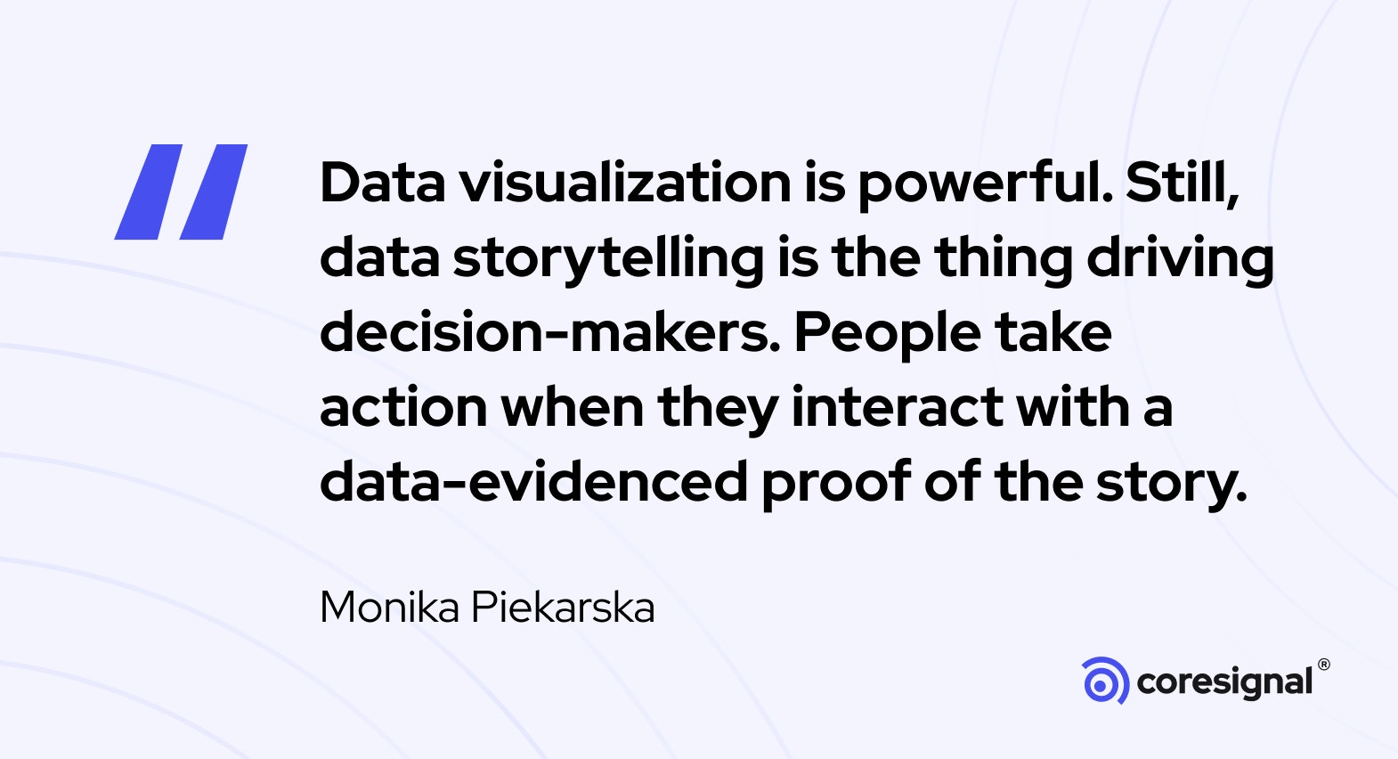
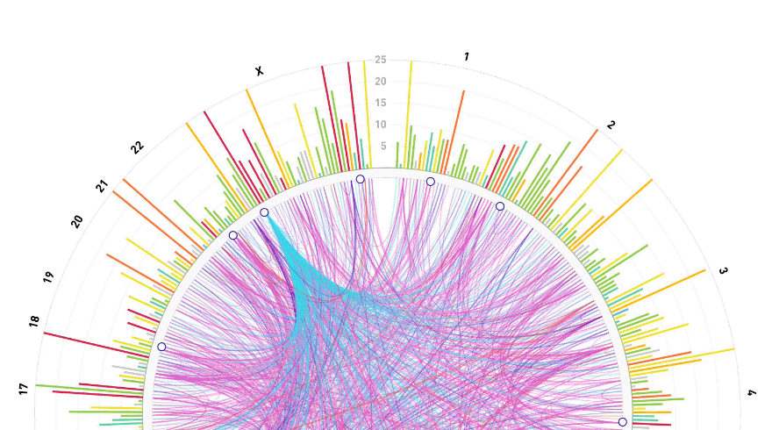

Slide 27
The Protips
Identify your Audience
Notes:
When and where can I communicate with them?
How do they like to consume information?
Who am I reporting to?

Slide 28
The Protips
Begin with a
clear problem statement or question
Notes:
What business decisions are affected?
What have they been told before?
How important is the decision?

Slide 29
The Protips
Provide context
Notes:
Decide which data will help you tell that story

Slide 30
The Protips
Map a journey

Slide 31
The Protips
Explain with visuals
Narrate with words

Slide 32
The Protips
Be concise

Slide 33
The Protips
End with a BANG!

Slide 34
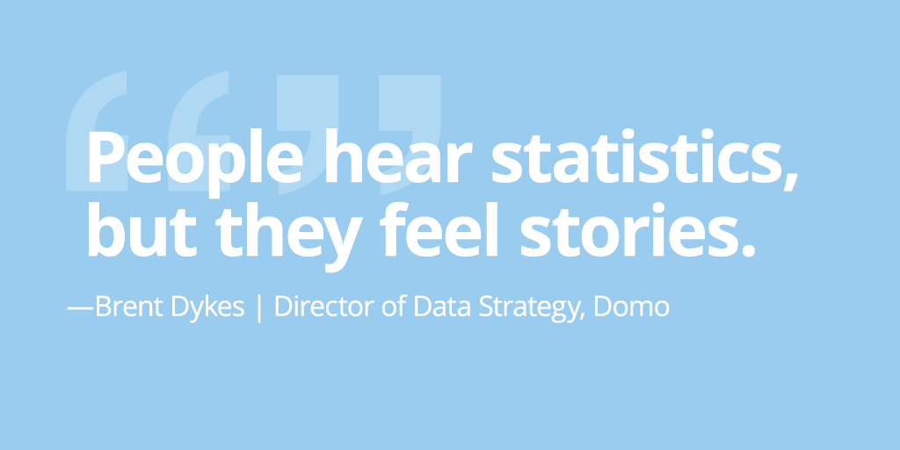

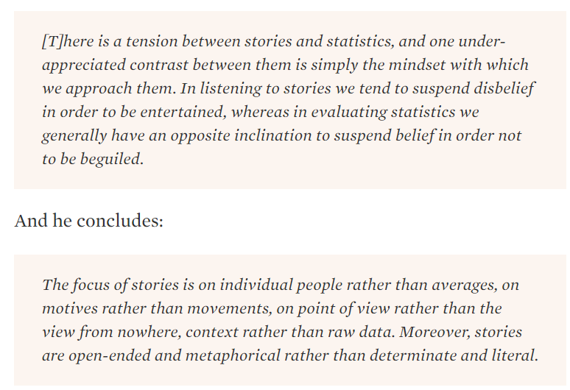
Notes:
At the end of the day It is memorability, persuasiveness and engagement
https://flowingdata.com/2010/11/29/statistics-vs-stories/

